Slide 1

NEOTECH INSTITUTE OF TECHNOLOGY Neotech campus
BACHELOR OF DIPLOMA
ENGINEERING IN
1 SEMESTER COMPUTER ENGINEERING
SUBMITTED BY
VEER PATEL
MANAN PATEL
SUBJECT: FUNDAMENTAL OF CUMPUTER APPLICATION
TOPIC : WEB DEVELOPMENT
AFFILATED TO GUJARAT TECHNOLOGICAL UNIVERSITY

Slide 2
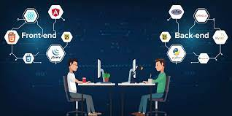
WEB DEVELOPMENT
Web development is the work involved in developing a website for the Internet (World Wide Web) .
Web development can range from developing a simple single static page of plain text to complex web applications, electronic businesses, and social network services.
There are three kinds of Web developer specialization: front-end developer, back-end developer, and full-stack developer.

Slide 3

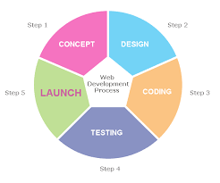
Steps of web development
There are basically seven steps of web development.
1) Information Gathering
2) Planning
3) Design
4) Content Writing and Assembly
5) Coding
6) Testing, Review and Launch
7) Maintenance
Maintenance is done by Check that all of your pages are loading without errors.
Check the load speed of your website and ensure that nothing is bogging it down.

Slide 4

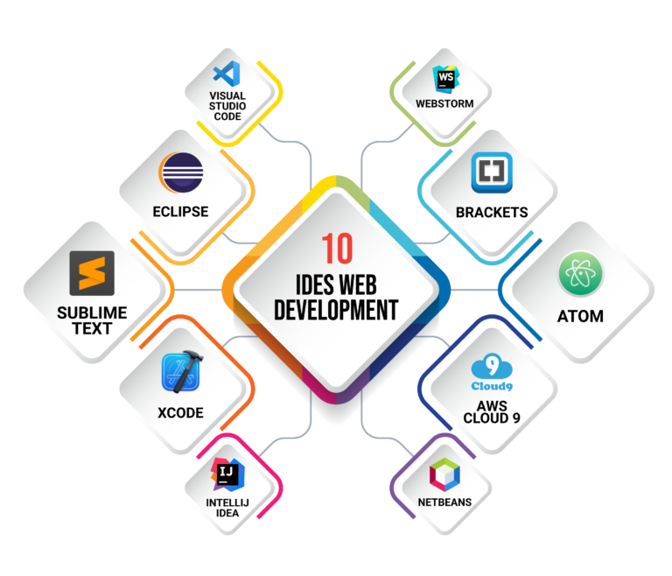
IDEs for web development
An integrated development environment (IDE) is software for building applications that combines common developer tools into a single graphical user interface.
This are the some IDEs
Visual Studio code by Microsoft
Atom by github.
Netbeans
Webstorm
Phpstorm
Pycharm
IntelliJ IDEA
With the help of this we can make responsive websites
and it becomes easy to code.

Slide 5

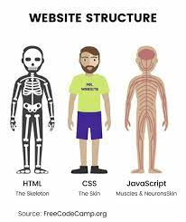
Front-end development
An overview: HTML provides the basic structure of sites, which is enhanced and modified by other technologies like CSS and JavaScript. CSS is used to control presentation, formatting, and layout. JavaScript is used to control the behavior of different elements.
In simple words HTML is like a skeleton , CSS is like skin and JAVASCRPT is like the brain of human.

Slide 6

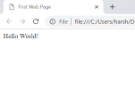
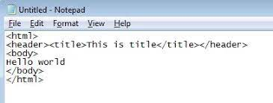
HTML
The HyperText Markup Language, or HTML is the standard markup language for documents designed to be displayed in a web browser.
Web browsers receive HTML documents from a web server or from local storage and render the documents into multimedia web pages
HTML provides a means to create structured documents by denoting structural semantics for text such as headings, paragraphs, lists, links, quotes and other items.

Slide 7

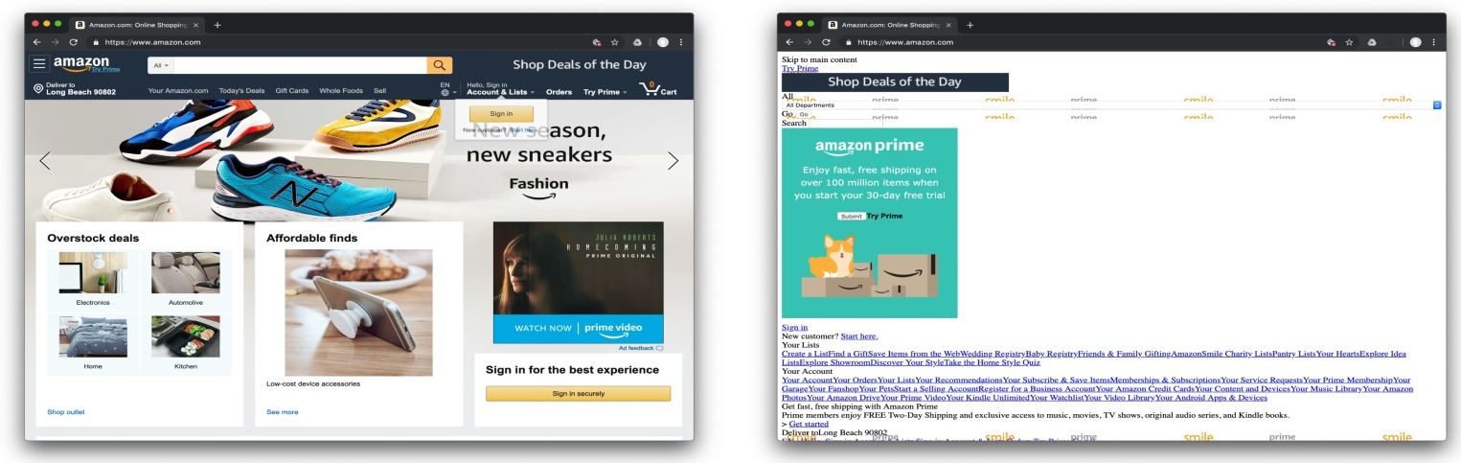
CSS
Cascading Style Sheets (CSS) is a style sheet language used for describing the presentation of a document written in a markup language such as HTML. Basically use to design website
CSS is designed to enable the separation of presentation and content, including layout, colors, and fonts.
CSS also has rules for alternate formatting if the content is accessed on a mobile device.
Webpage without CSS

Slide 8

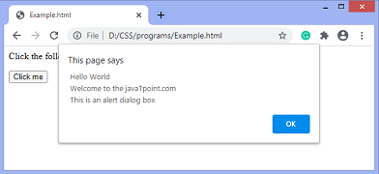
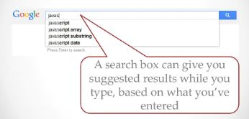
Javascript
JavaScript is high-level, often just-in-time compiled and multi-paradigm. It has dynamic typing, prototype-based object-orientation and first-class functions.
It allows us to add dynamic behavior to the webpage and add special effects to the webpage.
Using JavaScript, it is also possible to load the content in a document without reloading the webpage.
Javascript Alert function Example
Example of JS

Slide 9

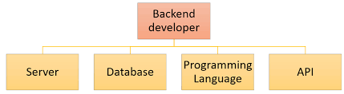
Back end development
Backend Development is also known as server-side development. It is everything that the users don't see and contains behind-the-scenes activities that occur when performing any action on a website.
Back-end programing language include python , php , java , c#
It focuses primarily on databases, backend logic, APIs(Application programming interface), and Servers.

Slide 10

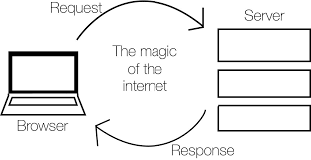
How front-end and back-end work together
A browser connects to a server.
That server sends the front-end to the browser.
From there, the front-end explains how the browser should communicate with the server.

Slide 11

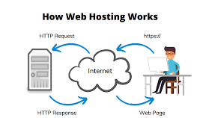
Web hosting
A web hosting service is a type of Internet hosting service that hosts websites for clients, i.e. it offers the facilities required for them to create and maintain a site and makes it accessible on the World Wide Web.
Domain Name System configuration to define name(s) for the sites and point them to the hosting servers.

